Slide 1
Chapter 9
Section 9.1: Pointers

Slide 2

Pointers
A pointer is the memory address of a variable
Memory addresses can be used as names for variables
If a variable is stored in three memory locations, the address of the first can be used as a name for the variable.
When a variable is used as a call-by-reference argument, its address is passed
An address used to tell where a variable is stored in memory is a pointer
Pointers "point" to a variable by telling where the variable is located

Slide 3
Declaring Pointers
Pointer variables must be declared to have a pointer type
Example:
To declare a pointer variable p that can "point" to a variable of type double:
double *p;
The asterisk identifies p as a pointer variable

Slide 4
Multiple Pointer Declarations
To declare multiple pointers in a statement, use the asterisk before each pointer variable
Example:
int *p1, *p2, v1, v2;
p1 and p2 point to variables of type int
v1 and v2 are variables of type int

Slide 5
The Address Of Operator
The & operator can be used to determine the address of a variable which can be assigned to a pointer variable
Example:
p1 = &v1;
p1 is now a pointer to v1
v1 can be called v1 or "the variable pointed to by p1"

Slide 6
The Dereferencing Operator
C++ uses the * operator in yet another way with pointers
The phrase "The variable pointed to by p" is translated into C++ as *p
Here the * is the dereferencing operator
p is said to be dereferenced

Slide 7
A Pointer Example
v1 = 0; p1 = &v1; *p1 = 42; cout << v1 << endl; cout << *p1 << endl; output:
42 42
v1 and *p1 now refer to the same variable

Slide 8
Pointer Assignment
The assignment operator = is used to assign the value of one pointer to another
Example:
If p1 still points to v1 (previous slide) then
p2 = p1;
Causes *p2, *p1, and v1 all to name the same variable

Slide 9
Caution! Pointer Assignments
Some care is required making assignments to pointer variables
p1 = p3; // changes location that p1 "points" to
*p1 = *p3; // changes value at location that // p1 "points" to

Slide 10
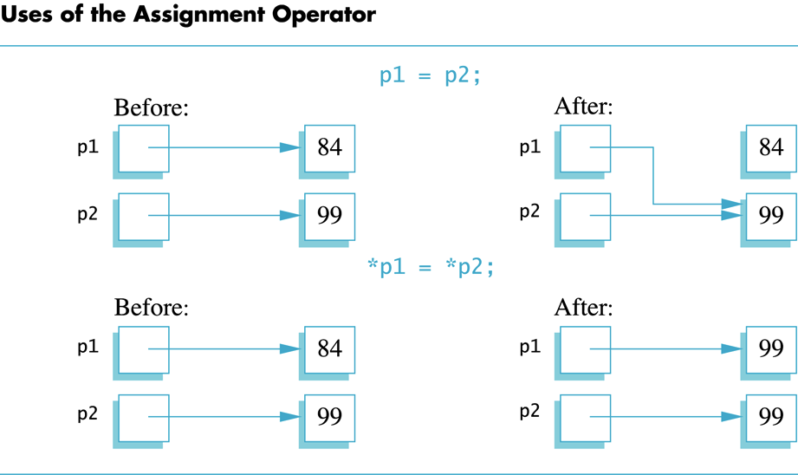
Assignment Operator and Pointers

Slide 11
The new Operator
Using pointers, variables can be manipulated even if there is no identifier for them
To create a pointer to a new "nameless" variable of type int:
p1 = new int;
The new variable is referred to as *p1
*p1 can be used anyplace an integer variable can
cin >> *p1; *p1 = *p1 + 7;

Slide 12
Dynamic Variables
Variables created using the new operator are called dynamic variables
Dynamic variables are created and destroyed while the program is running
Additional examples of pointers and dynamic variables are shown in Display 9.2
An illustration of the code in Display 9.2 is seen in Display 9.3

Slide 13
new and Class Types
Using operator new with class types calls a constructor as well as allocating memory
If MyType is a class type, then
MyType *myPtr; // creates a pointer to a // variable of type MyType
myPtr = new MyType; // calls default constructor
myPtr = new MyType (32.0, 17); // calls Mytype(double, int);

Slide 14
Basic Memory Management
An area of memory called the freestore or the heap is reserved for dynamic variables
New dynamic variables use memory in the freestore
If all of the freestore is used, calls to new will fail
Unneeded memory can be recycled
When variables are no longer needed, they can be deleted and the memory they used is returned to the freestore

Slide 15
The delete Operator
When dynamic variables are no longer needed, delete them to return memory to the freestore
Example:
delete p;
The value of p is now undefined and the memory used by the variable that p pointed to is back in the freestore

Slide 16
Dangling Pointers
Using delete on a pointer variable destroys the dynamic variable pointed to
If another pointer variable was pointing to the dynamic variable, that variable is also undefined
Undefined pointer variables are called dangling pointers
Dereferencing a dangling pointer (*p) is usually disasterous

Slide 17
Automatic Variables
Variables declared in a function are created by C++ and destroyed when the function ends
These are called automatic variables because their creation and destruction is controlled auto-matically
The programmer manually controls creation and destruction of pointer variables with operators new and delete

Slide 18
Type Definitions
A name can be assigned to a type definition, then used to declare variables
The keyword typedef is used to define new type names
Syntax:
typedef Known_Type_Definition New_Type_Name;
Known_Type_Definition can be any type

Slide 19
Defining Pointer Types
To avoid mistakes using pointers, define a pointer type name
Example:
typedef int* IntPtr;
Defines a new type, IntPtr, for pointer variables containing pointers to int variables
IntPtr p; is equivalent to int *p;

Slide 20
Multiple Declarations Again
Using our new pointer type defined as
typedef int* IntPtr;
Prevent this error in pointer declaration: int *P1, P2; // only P1 is a pointer variable
by using this instead:
IntPtr P1, P2; // both P1 and P2 are pointer // variables

Slide 21
Pointer Reference Parameters
A second advantage in using typedef to define a pointer type is seen in parameter lists
Example:
void sample_function(IntPtr pointer_var);
is less confusing than
void sample_function( int* pointer_var);

Slide 22
Dynamic Arrays
A dynamic array is an array whose size is determined when the program is running, not when you write the program

Slide 23
Pointer & Array Variables
Array variables are actually pointer variables that point to the first indexed variable
Example:
int a[10]; typedef int* IntPtr; IntPtr p;
Variables a and p are the same kind of variable
Since a is a pointer variable that points to a[0],
p = a;
causes p to point to the same location as a

Slide 24
Pointer & Array Variables
Continuing the previous example:
Pointer variable p can be used as if it were an array variable
Example:
p[0], p[1], …, p[9]
Are all legal ways to use p
Variable a can be used as a pointer variable except the pointer value in a cannot be changed
This is not legal: IntPtr p2; … // p2 is assigned a value a = p2 // attempt to change a

Slide 25
Creating Dynamic Arrays
Normal arrays require that the programmer determine the size of the array when the program is written
What if the programmer estimates too large?
Memory is wasted
What if the programmer estimates too small?
The program may not work in some situations
Dynamic arrays can be created with just the right size while the program is running

Slide 26
Creating Dynamic Arrays
Dynamic arrays are created using the new operator
Example:
To create an array of 10 elements of type double:
typedef double* DoublePtr; DoublePtr d; d = new double[10];
d can now be used as if it were an ordinary array!
This could be an integer variable!

Slide 27
Dynamic Arrays (cont’d)
Pointer variable d is a pointer to d[0]
When finished with the array, it should be deleted to return memory to the freestore
Example: delete [ ] d;
The brackets tell C++ a dynamic array is being deleted, so it must check the size to know how many indexed variables to remove
Forgetting the brackets, is not illegal, but would tell the computer to remove only one variable

Slide 28
Pointer Arithmetic
Arithmetic can be performed on the addresses contained in pointers
Using the dynamic array of doubles, d, declared previously, recall that d points to d[0]
The expression d+1 evaluates to the address of d[1] and d+2 evaluates to the address of d[2]
Notice that adding one adds enough bytes for one variable of the type stored in the array

Slide 29
Pointer Arithmetic Operations
You can add and subtract with pointers
The ++ and -- operators can be used
Two pointers of the same type can be subtracted to obtain the number of indexed variables between
The pointers should be in the same array!
This code shows one way to use pointer arithmetic: for (int i = 0; i < array_size; i++) {
cout << *(d + i) << " " ;
// same as cout << d[i] << " " ;
}

Slide 30
Arrays and Pointers
Pointer Arithmetic
When we add to a pointer, such as (p + 1), we do not literally add 1 to the pointer address
Instead, we add one “address” to the pointer
Be careful:
*(++p) works too, but now we have lost our pointer to the beginning of the array!!

Slide 31
Arrays and Pointers
Array variables are actually pointers
When you declare an array such as:
double data[3] = { 1.1, 2.2, 3.3 };
Identifier data (without brackets) is a pointer
data points to the first element of the array
data+1 points to the second element of the array
data+2 points to the third element of the array
*data has the value 1.1
*(data+1) has the value 2.2
*(data+2) has the value 3.3
data[2] is shorthand notation for *(data+2)

Slide 32
Passing Arrays to Functions
When we pass an array to a function, we are passing the array address
int sumArray(int arr[ ], int size);
int main()
{
int list[] = {1, 2, 3, 4};
…
int sum = sumArray(list, 4);
…

Slide 33
Passing Arrays to Functions
This works too … because array name is a pointer to the beginning of the array
int sumArray(int *arr, int size);
int main()
{
int list[] = {1, 2, 3, 4};
…
int sum = sumArray(list, 4);
…

Slide 34
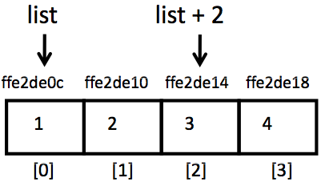
Arrays and Pointers
*list – contents point to by list
*(list+2) – contents at list[2]
Indexing an array is just a way of finding a particular address in that block
int list[] = {1, 2, 3, 4}; // array of 4 ints
…
cout << list[2] << endl;
This is equivalent to:
cout << *(list + 2) << endl;

Slide 35
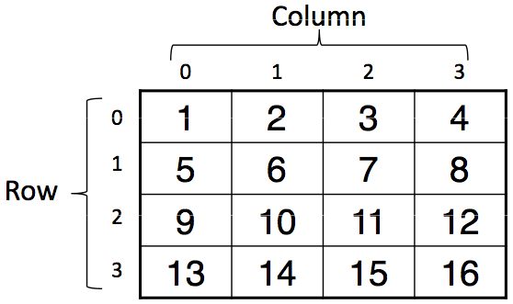
2-D Arrays
int myMatrix[ROWS][COLS]

Slide 36
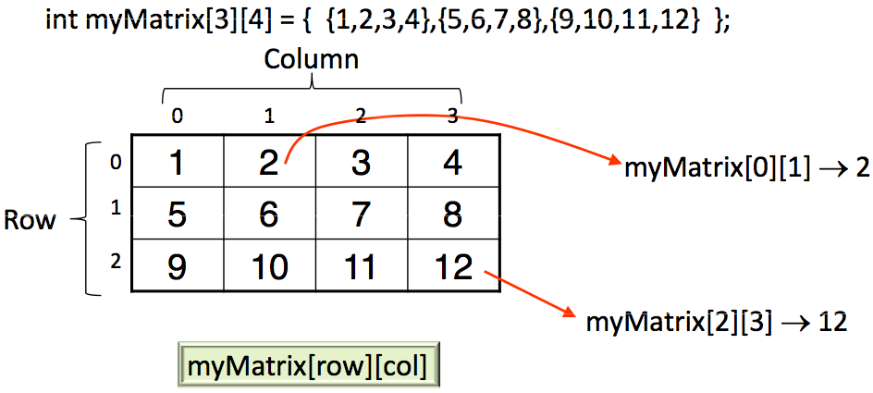
2-D Arrays

Slide 37
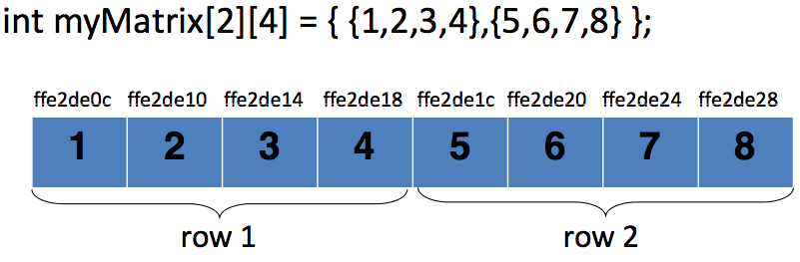
2-D Arrays
Physically, in one block of memory
Array elements are stored in row major order
Row 1 first, followed by row 2, row 3, and so on

Slide 38
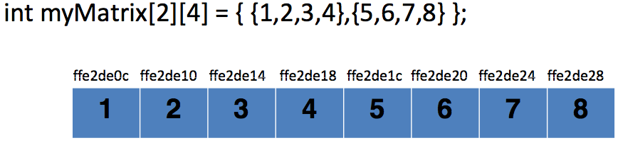
2D Array Name and Addresses
myMatrix pointer to first element of 2D array
myMatrix[0] pointer to first row of 2D array
myMatrix[1] pointer to second row of 2D array
*myMatrix[1] address of element myMatrix[1][0]

Slide 39
Accessing 2D Array Elements
Indexing myMatrix[i][j] is the same as:
*(myMatrix[i] + j)
(*(myMatrix + i))[j]
*((*(myMatrix + i)) + j)
*(&myMatrix[0][0] + 4*i + j)

Slide 40
Arrays as Arguments to Functions
#include <iostream>
using namespace std;
const int SIZE = 10;
void init(int a[]);
int main()
{
int a[SIZE];
init(a);
return 0;
}
void init(int a[])
{
for (int i = 0; i < SIZE; i++)
{
a[i] = 0;
}
}
Equivalent pointer alternative:
void init(int *a)
{
for (int i = 0; i < SIZE; i++)
{
*(a+i) = 0;
}
}

Slide 41
Passing 2D Arrays to Functions
If we wanted to pass multi-dimensional arrays to functions, we need to be clear about the function declaration
To pass a statically allocated array to a function, we must specify the number of columns
For example, to declare a function that takes the array float a[2][3] as its argument, we would use
void Function(float a[][3]) { … }
The reason we need to do this is because the compiler needs to know the number of columns in order to jump from one row to the next in a statically declared array

Slide 42
Passing 2D Arrays to Functions
Alternatively, to declare a function to take a double pointer float **a, you use
void Function(float **a) { … }
Then, inside the function, you can refer to the elements of the multi-dimensional array using the standard a[i][j] notation.
This form of a function declaration works only for dynamically declared arrays

Slide 43
2D Dynamic Array Example
#include <iostream.h>
float find_average(int **, int, int); // function prototype
void main()
{
int **arr2D;
arr2D = new int*[numRows];
for(i=0; i<numRows; i++)
{
arr2D[i] = new int[numCols];
}
// then, initialize array …
cout << ”Average is " << find_average(arr2D, numRows, numCols);
cout << endl;
}

Slide 44
2D Dynamic Array Example (cont’d)
float find_average(int **vals, int n, int m)
{
int i, j;
float avg = 0.0;
for (i = 0; i < n; i++)
{
for (j = 0; j < m; j++)
{
avg += vals[i][j];
}
}
avg = avg/(n*m);
return avg;
}

Slide 45
Multidimensional Dynamic Arrays
To create a 3x4 multidimensional dynamic array
View multidimensional arrays as arrays of arrays
First create a one-dimensional dynamic array
Start with a new definition:
typedef int* IntArrayPtr;
Create a dynamic array of pointers named m: IntArrayPtr *m = new IntArrayPtr[3];
For each pointer in m, create a dynamic array of int's
for (int i = 0; i<3; i++)
{
m[i] = new int[4];
}

Slide 46
A Multidimensional Dynamic Array
The dynamic array created on the previous slide could be visualized like this:
m
IntArrayPtr's
IntArrayPtr *
int's

Slide 47
A Multidimensional Dynamic Array
To delete a multidimensional dynamic array
Each call to new that created an array must have a corresponding call to delete[ ]
Example:
To delete the dynamic array created on a previous slide:
for ( i = 0; i < 3; i++) {
delete [ ] m[i]; //delete the arrays of 4 int’s
}
delete [ ] m; // delete the array of IntArrayPtr's

Slide 48
Chapter 9
Dynamic Memory Allocation in C

Slide 49
Introduction
The purpose of dynamic/run-time memory allocation in C is the same as in C++ :user decides the memory size required at run-time
Four functions are used in dynamic memory management in C

Slide 50
malloc()
malloc () is equivalent to keyword new in C++
Syntax:
ptr = (cast-type*) malloc(byte-size)
For example,
int *ptr=(int*)malloc(100*sizeof(int))
Compare with int *ptr=new int[100] in C++

Slide 51
calloc()
calloc () allocates memory in contiguous blocks and sets all bytes to zero
Syntax:
ptr = (cast-type*) calloc(n, element size)
For example,
int *ptr=(int*)calloc(100,sizeof(int))

Slide 52
free()
After the data stored in allocated memory has served its purpose, it is better to de-allocate the memory in order to free it for future use
It is equivalent to delete keyword in C++
Syntax
free(ptr)

Slide 53
realloc
If a previously allocated memory is deemed insufficient, then we can resize the allocated memory using realloc
Syntax
ptr=realloc(ptr, new_byte_size);

Slide 54
Example
#include "stdio.h"
#include "stdlib.h"
int main()
{
int* my_array,i; //an integer pointer
int num;
printf("How many data points?");
scanf ("%d",&num);
my_array=(int*)malloc(num*sizeof(int));
for (i=0;i<num;++i)
{
printf ("Enter data #%d:",i+1);
scanf("%d",&my_array[i]);
}
printf("You entered\n");
for (i=0;i<num;++i)
printf("%d \n",my_array[i]);
free(my_array);
return 0;
}

